Slide 1
FEDRIGONI

Slide 2
Fedrigoni Group
Italian Specialist paper manufacturer
Mill and Head Quarters in Verona, Italy
Over 125 years
Group turnover, over €1 Billion
Over 2700 employees
11 paper machines
A global business with subsidiaries in UK/France/Spain/Germany/Benelux/China/& Brazil
Universal brand – sells to over 110 countries worldwide

Slide 3
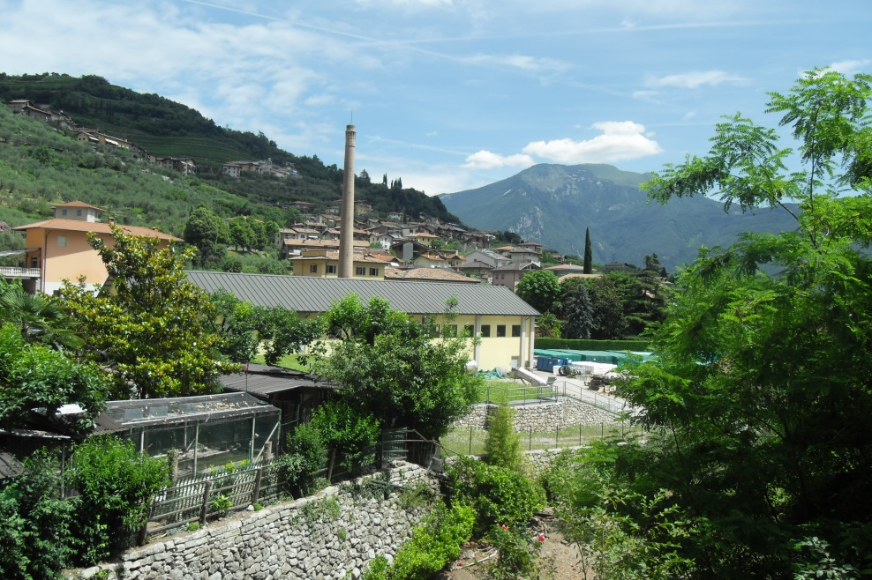
Fedrigoni Group
Fedrigoni
Fabriano
Fabriano Securities
Fabriano Boutique
Manter
Arconvert

Slide 5
History Paper
103 China Ts’ai Lun invents paper bamboo and shrubs
1173 Paper is made middle east linen and hemp
1264 Paper making Fabriano begins
1293 Fabriano invents watermarking
1455 Gutenburg print first bible with movable type
1496 Aldo Manuzio print greek books in Venice on Fabriano paper
1502 Raffaello sketches on fabriano paper
1509 Michelangio uses fabriano paper in a letter to Nicolo

Slide 6
1717 Giuseppe Fedrigoni founded the San Colombano paper mill at Trambilleno.
1888 Giuseppe Antonio Fedrigoni founded the paper mill in Verona.
1938 Gianfranco Fedrigoni, grandson of Giuseppe, acquired the Varone paper mill adding it to the existing plant.
1945 Shortly before the end of the war, the Verona paper mill was completely destroyed during a bombing raid. The family and some employees financed reconstruction using their own savings, without receiving state aid or funds from the Marshall Plan

Slide 7
Manufacture over 3000 products

Slide 8
Coloured Smooth
Ispira
Materica
Pergamente Marina
Savile Row Plain
Sirio
Woodstock

Slide 9
Coloured Textured
Imitlin
Merida
Nettuno
Tintoretto Ceylon
Savile Row Pinstripe/Tweed
Sirio /E

Slide 10
White & Ivory Coated
Symbol Gloss
Symbol Satin
Symbol E/E
Symbol Matt Plus
Symbol Tatami
Symbol Card

Slide 11
Castcoated
Splendorlux
Light Weights
Colours
Emboss
Metal
Pearl
Versus

Slide 12
Pearlescent
Constellation Jade
Pergamenata Pearl
Sirio Pearl
Sirio Pearl Merida
Splendorlux Pearl
Symbol Pearl

Slide 13
Book & Box
Brussulin XT
Imitlin
Poliwrap

Slide 14
Recycled Papers
Freelife Cento 100% recycled
Freelife Kendo 5% Hemp 40% recycled
Freelife Vellum 40% recycled
Woodstock 80% recycled 20% ecf
15 shades 7 weights

Slide 15
White & Ivory
Smooth 23 ranges
Textured 19 ranges

Slide 16
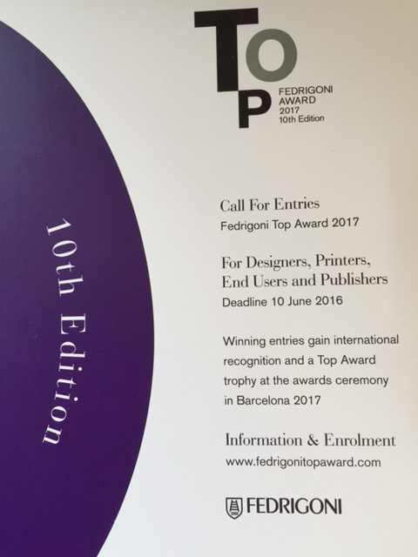
Top Awards

Slide 18
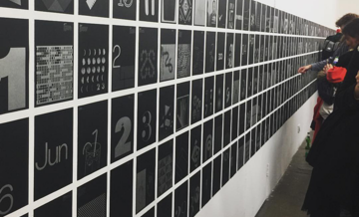
365 Calendar 2018

Slide 19
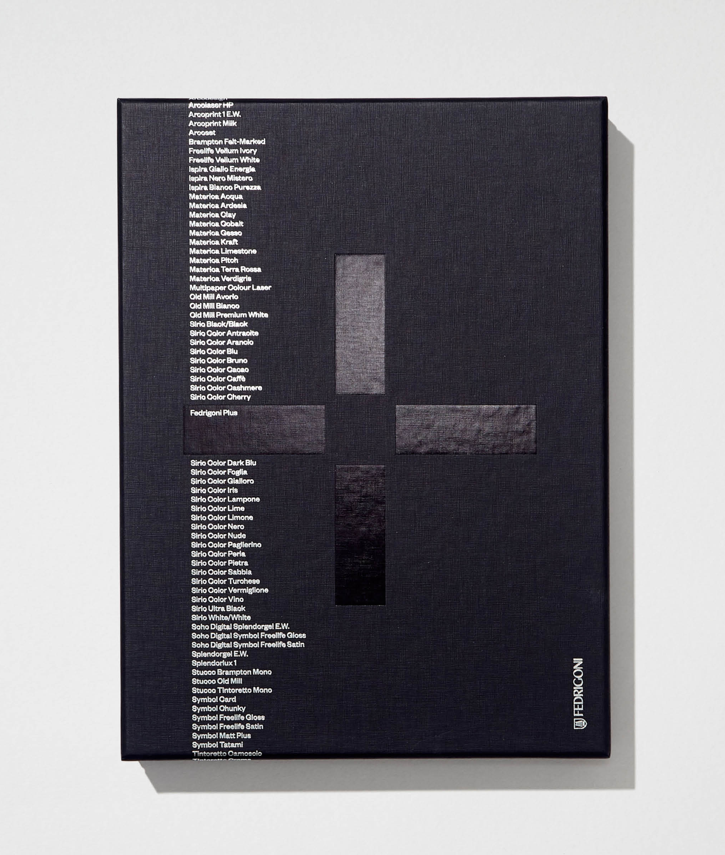
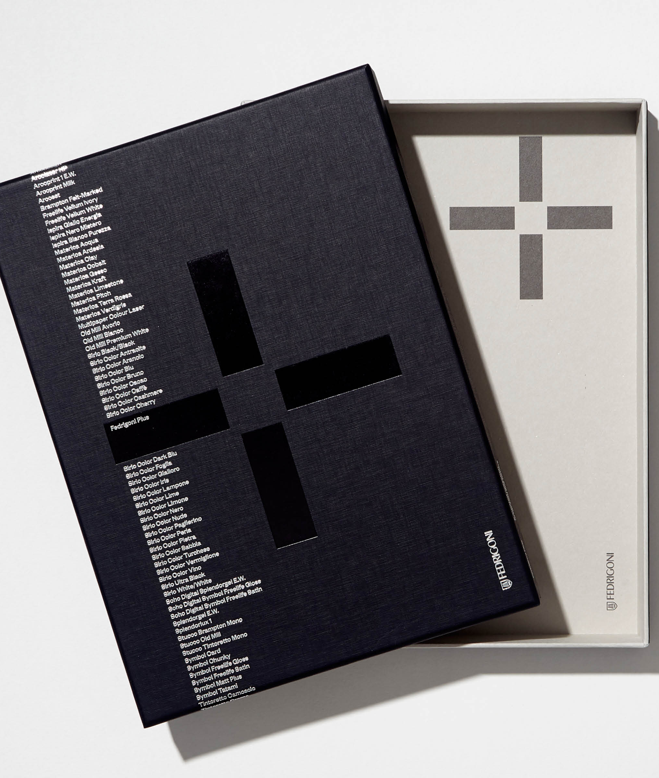
Fedrigoni+

Slide 20
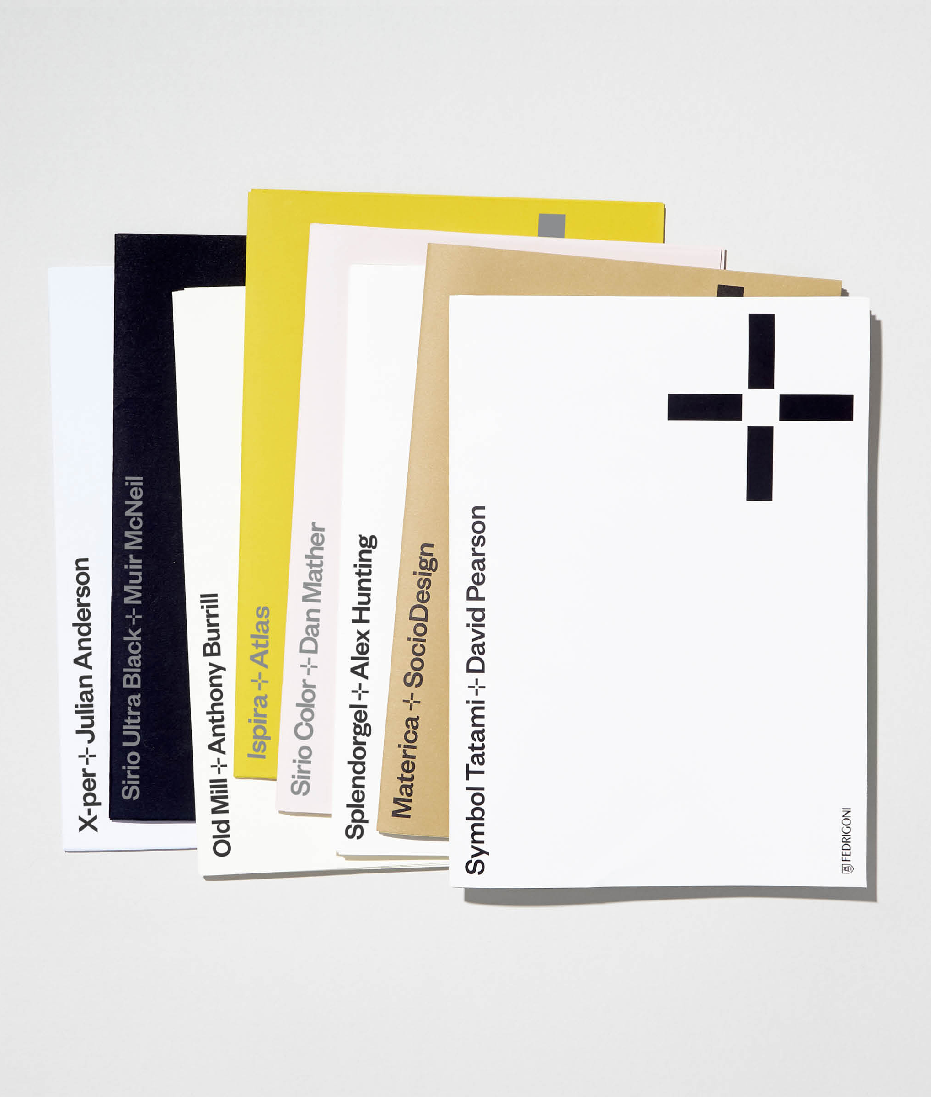
Fedrigoni+
Designer + Paper
  Socio Design + Materica
  David Pearson + Symbol Tatami
  MuirMcNeil + Sirio Ultra Black
  Alex Hunting + Splendorgel
  Atlas + Ispira
  Julian Anderson/TM + X-Per
  Anthony Burrill + Old Mill
  Dan Mather + Sirio Color Nude
Quarterly release
  Materica Kraft + Symbol Tatami Ivory
  Sirio Ultra Black + Splendorgel
  Ispira Giallo Energia + X-Per
  Old Mill Avorio + Sirio Color Nude

Slide 21
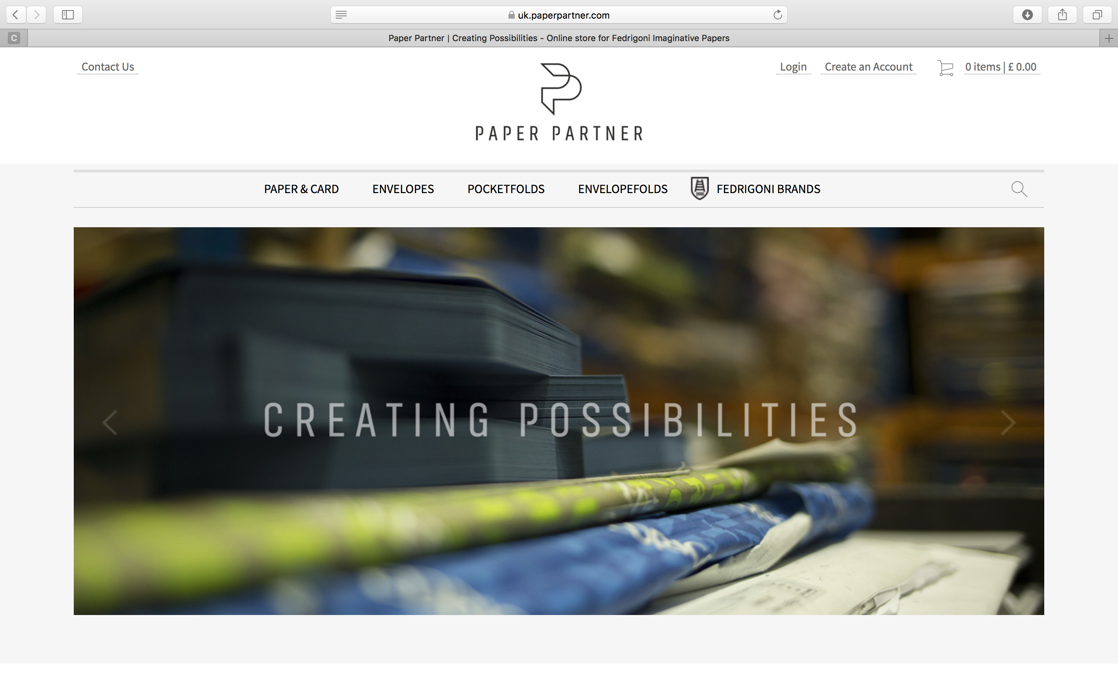
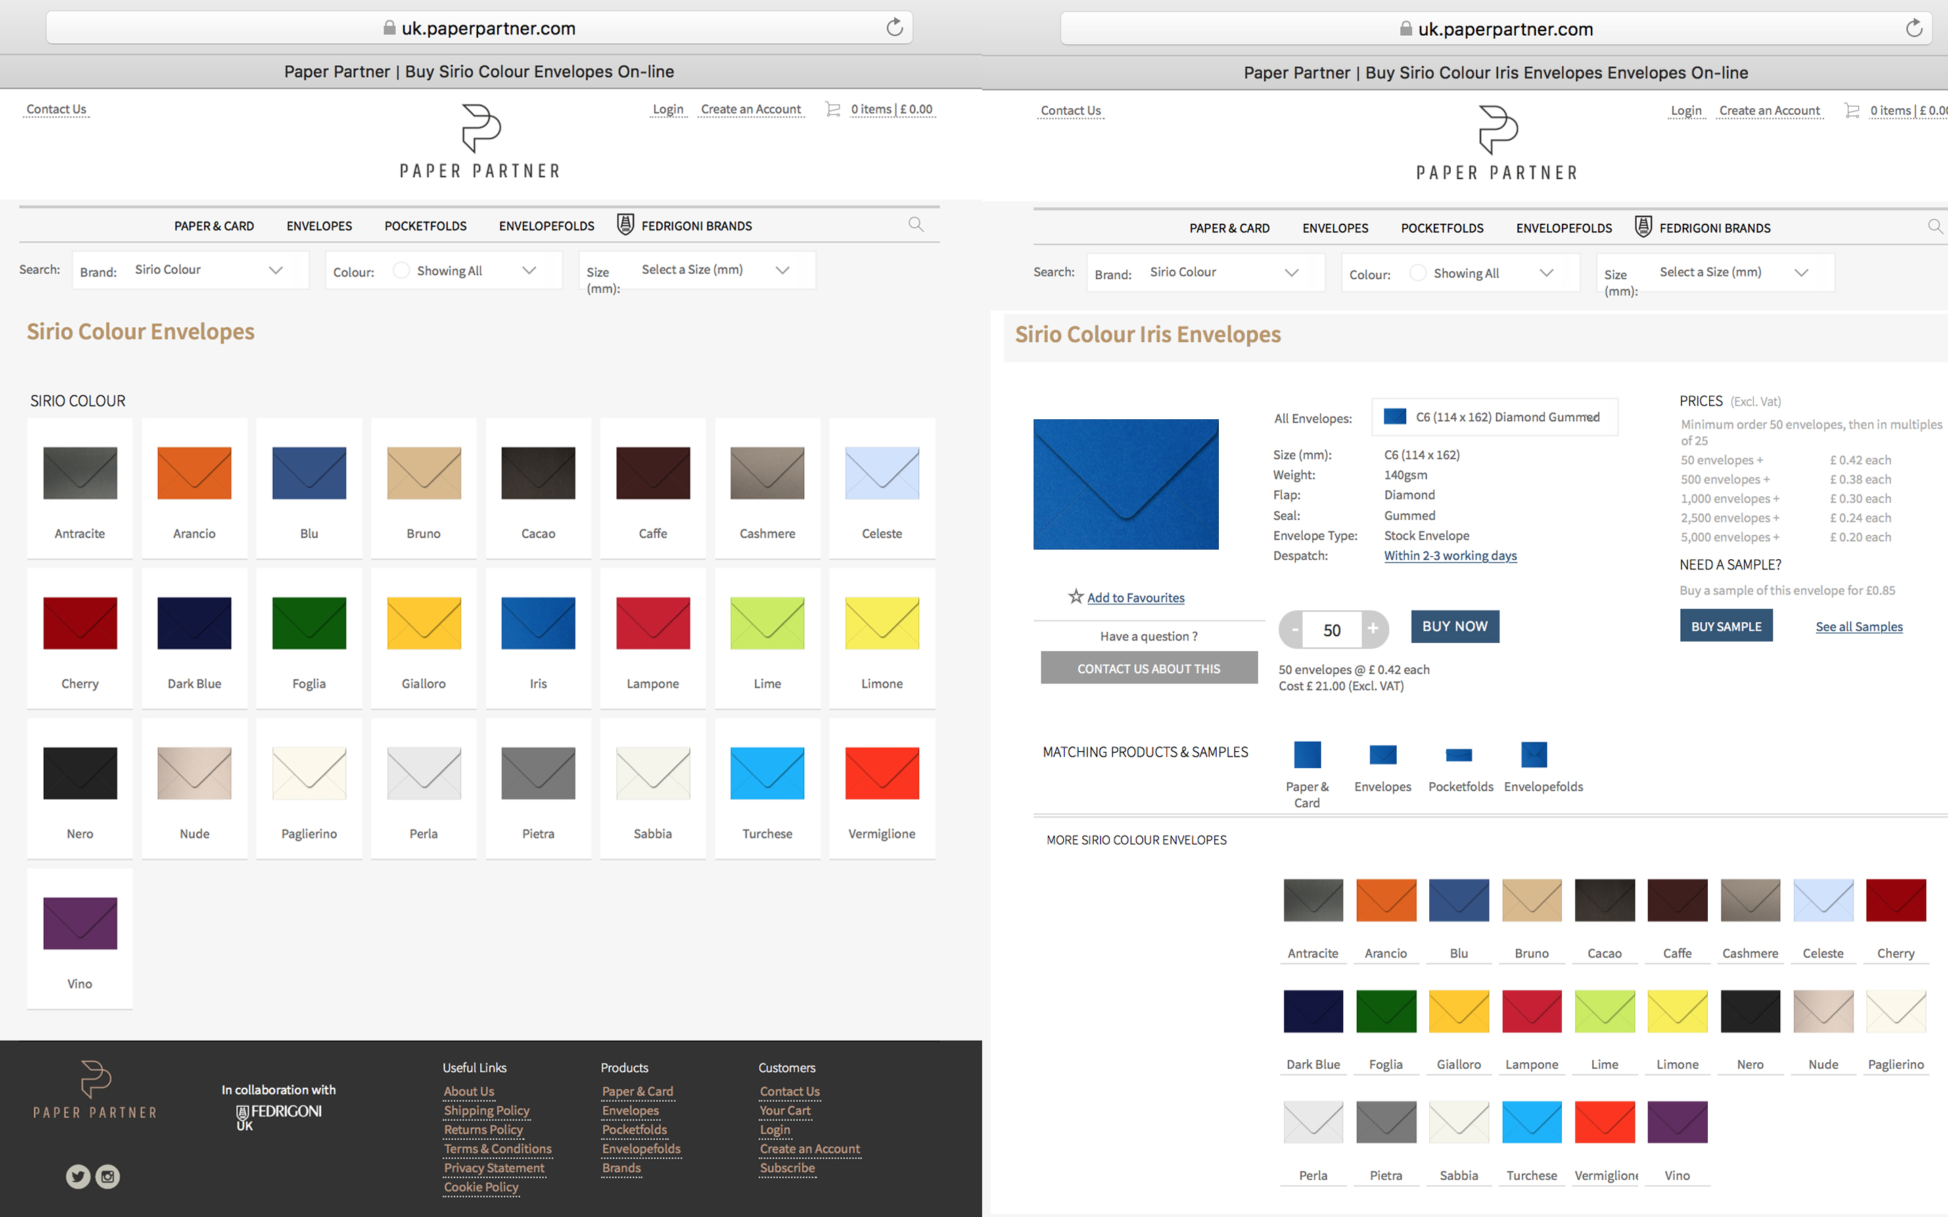
Paper Partner
Paper Partner
  Website launched March 23 2018
  An online collaboration between Fedrigoni and a business in Ireland.
  Specialises in envelopes for personal or commercial project but also supplies cutsize orders (A5, A4, A3, SRA3) of any Fedrigoni paper with no competitors present on the website.
  A line to market that allows us to reach end users, consumers and printers and gives us the ability to offer any product with a matching envelope in a large range of standard and bespoke sizes.
  Minimum order of 50 envelopes, any product in a large range of standard and bespoke sizes as well as single samples.

Slide 22
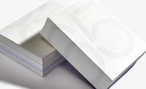
Fedrigoni 365/19

Slide 23
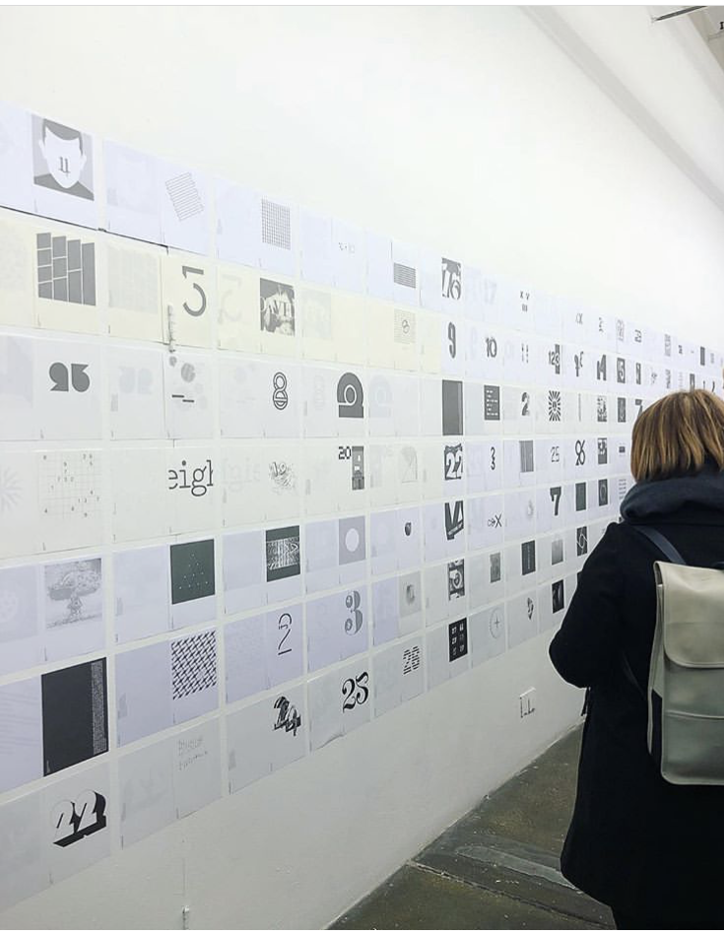
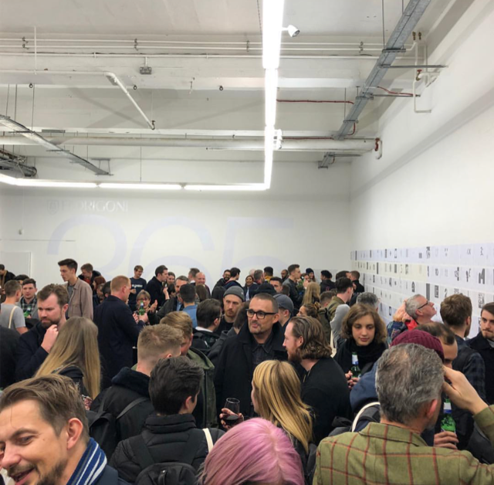
365/19

